Slide 1








VORTEXA
3.0
12 HRS HACKATHON
POWERED BY A.I.R.S
DOMAIN & NO : 1, C-03
PROBLEM STATEMENT TITLE :
PromptShield: Prompt Injection & Data-Exfiltration
Defence
TEAM NAME :
Alpha Syntax Squad
TEAM ID :
OnSpot2

Slide 2


PROBLEM STATEMENT
Language-model applications are vulnerable to direct and indirect prompt injection attacks, where malicious instructions hidden in user inputs, documents, or tool outputs attempt to override system rules, expose sensitive information, or leak data. Traditional keyword-based filters often fail to detect disguised attacks and may block legitimate content. A reliable middleware solution is needed to detect threats contextually, enforce editable security policies, sanitize unsafe content, and evaluate detection accuracy while minimizing false positives.

Slide 3
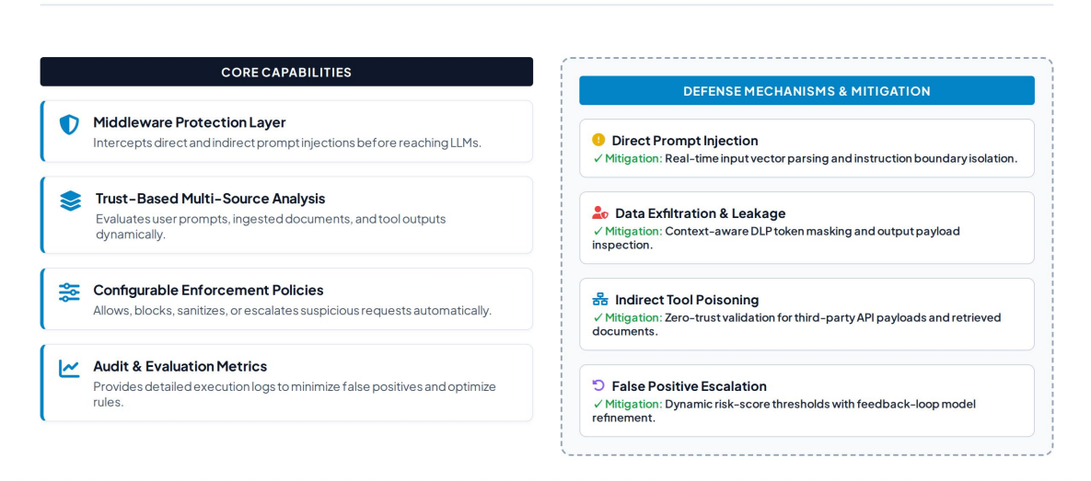
IDEA TITLE / PROPOSED SOLUTION
PromptShield: Intelligent Prompt Injection & Data-Exfiltration Defense
Proposed Solution
Develop a security middleware layer that detects and prevents direct and indirect prompt injection attacks before they reach a language model. PromptShield analyzes user inputs, documents, and tool outputs based on their trust levels, identifies attempts to override instructions or leak sensitive data, and applies configurable policies to allow, block, sanitize, or escalate suspicious content. It also provides audit logs and performance metrics to evaluate detection accuracy and minimize false positives.

Slide 4
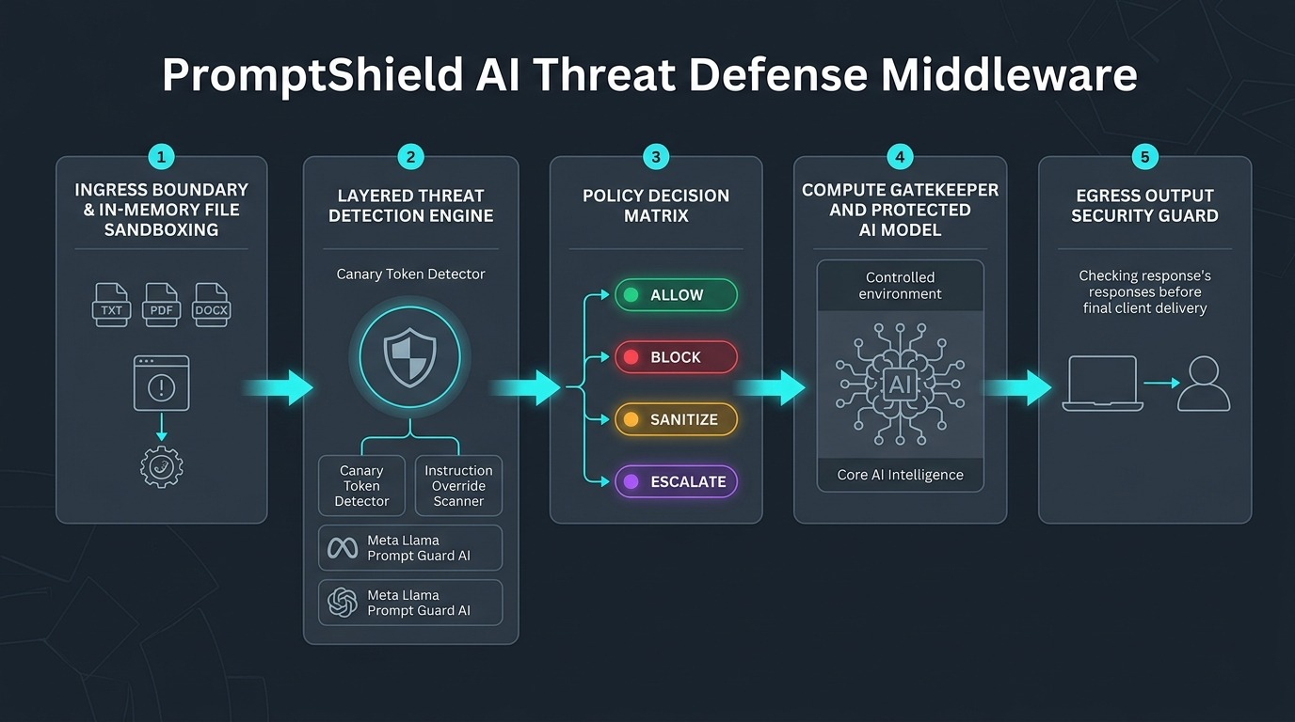
TECHNICAL APPROACH

Slide 5
FEASIBILITY AND VIABILITY
Technical Feasibility: Can be developed using Python, Flask, and LLM APIs with existing security techniques.
Cost-Effective: Open-source tools and libraries can reduce development costs.
Scalability: Can be extended to support multiple AI models and applications.
Real-Time Detection: Can analyze prompts and flag suspicious instructions before processing.
Data Privacy: Helps prevent unauthorized disclosure of confidential information.
Reduced Security Risks: Adds an extra layer of protection against prompt injection and data leakage.
Modular Architecture: Detection, sanitization, access control, and monitoring can be developed independently.
User-Friendly Interface: A simple dashboard can display threat levels, alerts, and security logs.
Technical Feasibility- Uses existing technologies such as Python, LLM APIs, and rule-based detection.- Can be developed using open-source frameworks and standard web technologies.- Can integrate with existing AI applications as a security layer.
2. Economic Feasibility- Open-source tools
reduce development costs.- A prototype
can be developed with limited resources.- API
usage and hosting costs can be managed
according to project requirements.
3. Operational Feasibility- Provides automated
detection of suspicious prompts. Offers
alerts and security logs for monitoring
threats.- Can be integrated into AI-based
chatbots and document-processing systems.
VIABILITY:
FEASIBILITY:

Slide 6
IMPACT AND BENEFITS
IMPACT :
BENEFITS :
Threat Detection: Identifies suspicious prompts and instructions.
Data Protection: Helps prevent unauthorized information disclosure.
Access Control: Restricts unauthorized tool usage and actions.
Real-Time Monitoring: Flags suspicious activities and maintains security logs.
Scalability: Can be integrated into chatbots and other LLM-based applications.
Cost-Effectiveness: Supports development using open-source tools and existing technologies.
Reduces the risk of prompt injection attacks.
Strengthens security in AI-powered applications.
Minimizes the chances of sensitive data exposure.
Promotes safer and more trustworthy AI interactions.
Improves awareness of emerging AI security threats.

Slide 7
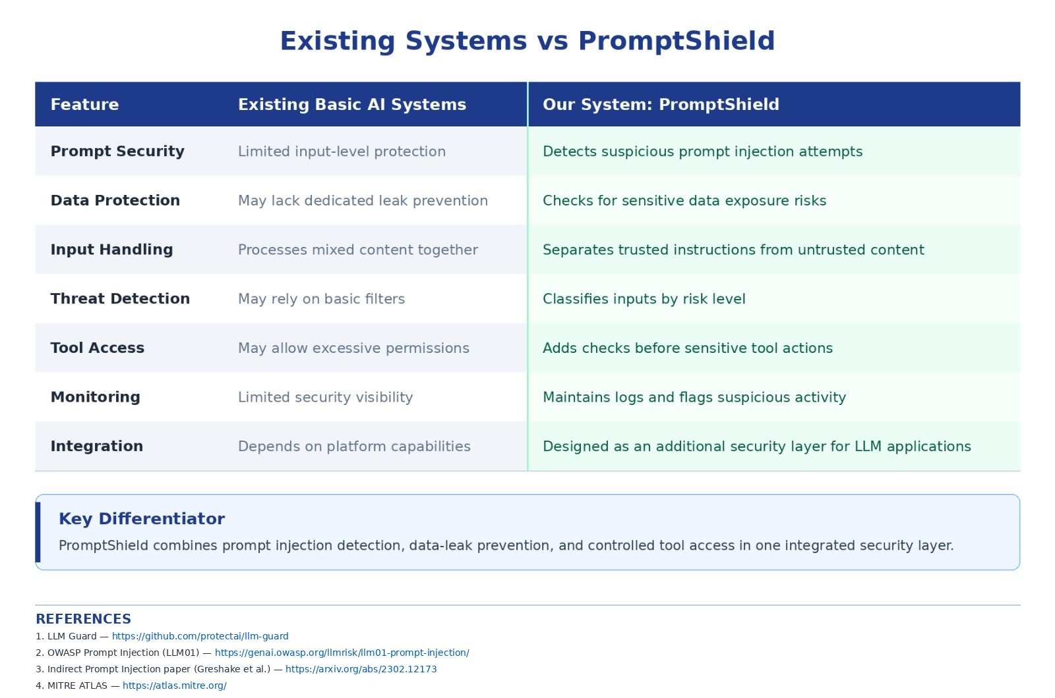
DIFFERENTIATOR

Slide 8










THANK YOU!
Game’s
Still On
VORTEXA 3.0
AIRS

